Slide 1
ADC LAB
Mohamed Saied
Introduction to the Analog World using STM32

Slide 2
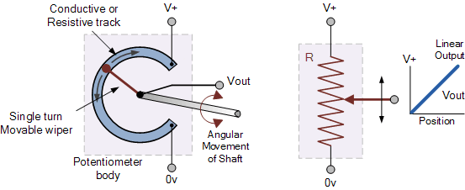
ADC LAB 01
Configure Analog to Digital Converter
Read potentiometer

Slide 3
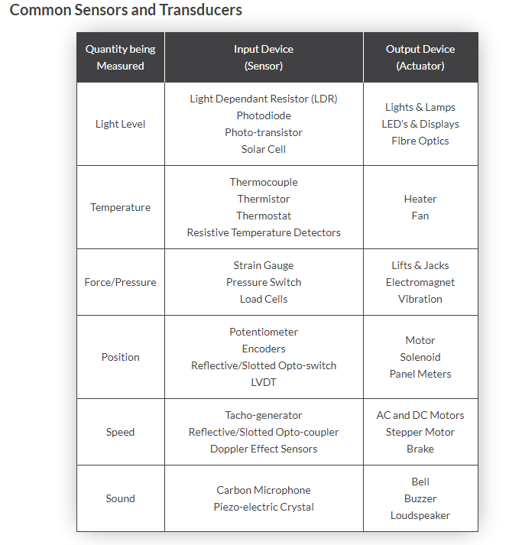
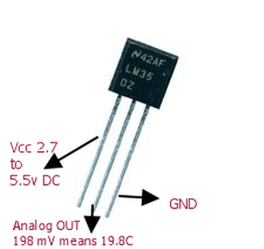

Slide 4
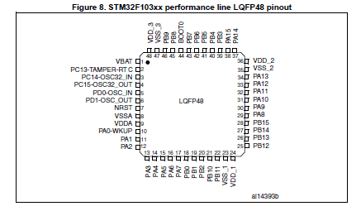
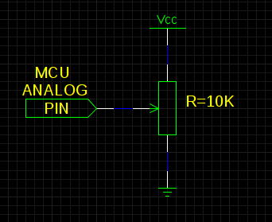
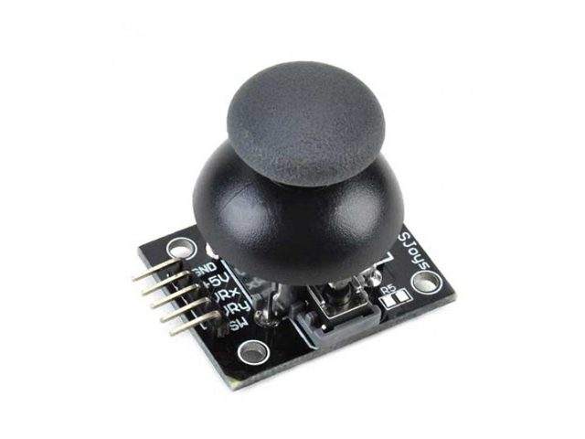
POT Connection

Slide 5
LAB 02
Select on of the sensors and interface with it and show the readings to terminal of uart1
Select [LDR] for example

Slide 6
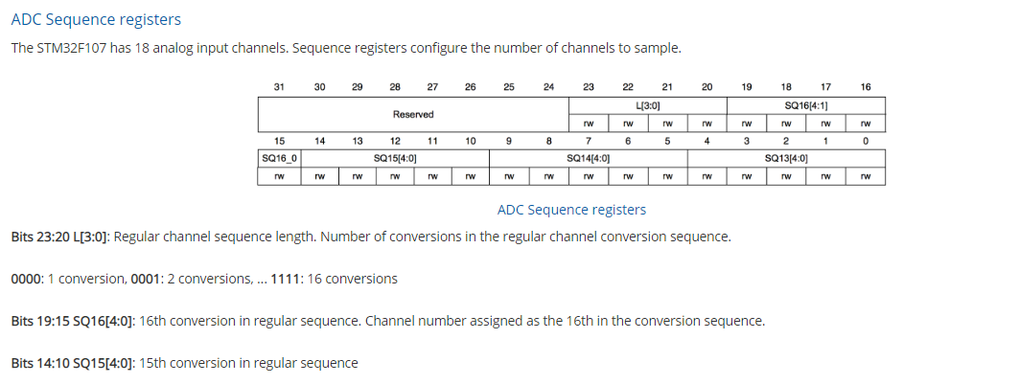
Setup

Slide 7

Sequencers
Here is the code to configure channel ADC_IN14 to be the first converted

Slide 8
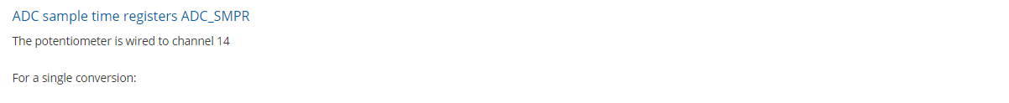
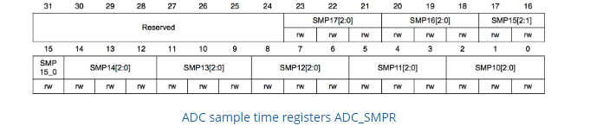
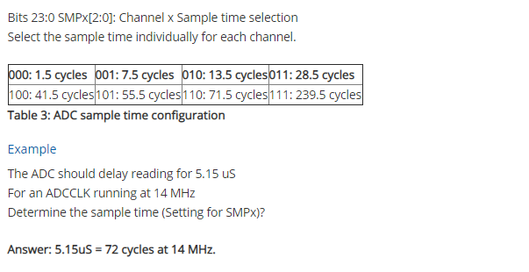
Sample Time Calculation

Slide 9
ADC Control Registers
ADC Control Registers (ADC_CR)
The ADC is controlled using two control registers ADC_CR1 and ADC_CR2 Bit 8 SCAN (Scan mode): In this mode, the inputs selected through ADC_SQRx registers are converted. Bit 5 EOCIE (Interrupt enable for EOC): enable/disable the End of Conversion interrupt.

Slide 10
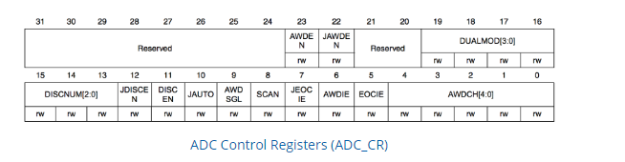
ADC Control Reg

Slide 11
Interrupt Enable
To interrupt the microcontroller at the end of conversion:
ADC->CR1|=1<<5;
EOC interrupt
NIVC->ISER[0] |= (1<<18);
Interrupt number 18

Slide 12
ADC Control Registers configuration
ADC1->CR2|=1<<20
Set SWSTART as trigger
ADC1->CR2|=7<<17
Enable external trigger
ADC1->CR2&=~1<<11
Right data alignment
ADC1->CR2->|=1<<0
Turn ADC ON
ADC1->CR2|=1<<1
Continuous Conversion

Slide 13
Configuration in one step using bitwise
To perform all the operations above in one statement, we can use a bitwise-OR operation
Enable external trigger, EXTSEL = SWSTART, Continuous conversion, ADC enable
ADC1->CR2 = (1 << 20) | (7 << 17) | (1 << 1) | (1 << 0) ;

Slide 14
Calibration
while(ADC1->CR2&(1<<3));
reset calibration
ADC1->CR2|=1<<3
Wait until Reset is finished
ADC1->CR2|=1<<2
Start Calibration
ADC1->CR2->|=1<<22
Start Conversion
while(ADC1->CR2&(1<<2));
Continuous Conversion

Slide 15
ADC Status Register
ADC Status (ADC_SR)
Bit 4 STRT: Regular channel Start flag Bit 3 JSTRT: Injected channel Start flag Bit 2 JEOC: Injected channel end of conversion Bit 1 EOC: End of conversion Bit 0 AWD: Analog watchdog flag

Slide 16
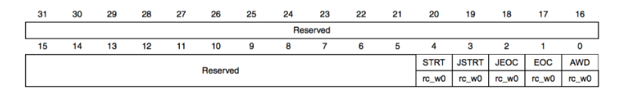
Status Register Cont’

Slide 17
Getting Values from Data Register
If(ADC1->SR&(1<<1)) // If conversion has finished (Check EOC bit)
Value=ADC1->DR&0x0FFF// Read AD converted value
ADC1->CR2|=1<<22// Start new conversion

Slide 18
References
https://www.electronics-tutorials.ws/io/io_2.html
Reference Manual of STM32F10xx Series
Stm32f103xC Datasheet

